Slide 1
7/22 알고리즘 스터디
자료구조 정리
with Python
박승준

Slide 2
목차
6. Hash Table (Dictionary)
7. Tree
7.1. Binary Search Tree
7.2. AVL Tree
7.3. B-Tree
7.4. Red-Black Tree
8. Heap
9. Graph
10. 문제 풀이
자료구조란
Array (List)
Stack
Queue
Linked-list

Slide 3
1. 자료구조란?
A data structure is a data organization, management, and storage format that
enables efficient access and modification. -Wikipedia
데이터를 효과적으로 접근하고(탐색) 변경, 저장하기 위해 사용
그림. BST

Slide 4
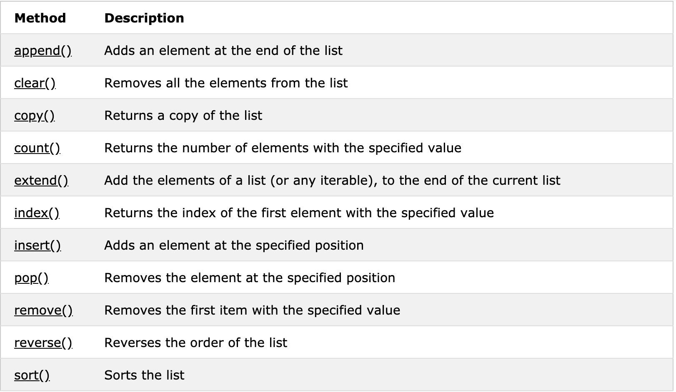
2. Array
An array data structure, or simply an array, is a data structure consisting of a collection of
elements (values or variables), each identified by at least one array index or key. -Wikipedia
파이썬에서는 array 대신 list 자료 구조를 사용할 수 있다. 좌측은 list에서 사용 가능한 method 목록.
(출처: https://www.w3schools.com/)
다음 할 일) list를 활용해서 stack과 queue를 구현해보자

Slide 5
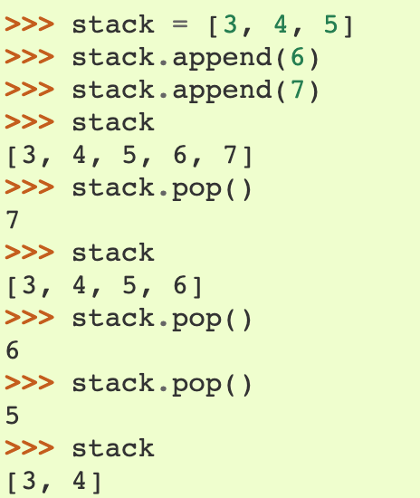
3. Stack
Push/Pop이 가능한 자료구조 (LIFO)
In Python,
Push = append
1. 스택 초기화
stack = []
2. Push
stack.append(x)
3. Pop
stack.pop()
Q. 비어 있는 stack을 pop하면 어떻게 될까?
IndexError: pop from empty list 발생
각 작업의 효율성
https://wiki.python.org/moin/TimeComplexity

Slide 6
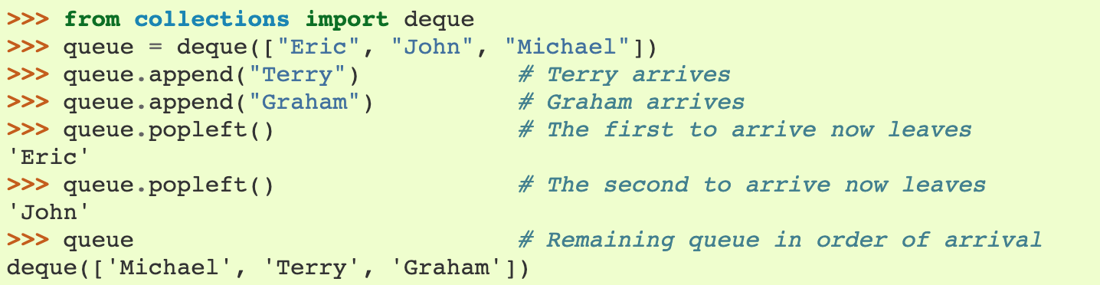
4. Queue
A queue is a collection of entities that are maintained in a sequence and can be modified by the
addition of entities at one end of the sequence and the removal of entities from the other end of
the sequence. (FIFO) - Wikipedia
In Python,
List 사용은 비효율적 collections.deque 사용 - 메모리 할당 방식의 차이 (linked list와 연결)
초기화 queue = deque([x, y, z]) 2. enqueue = append 3. dequeue = popleft()
참고) deque – ‘deck’이라 발음한다. / Circular Queue, Priority Queue

Slide 7
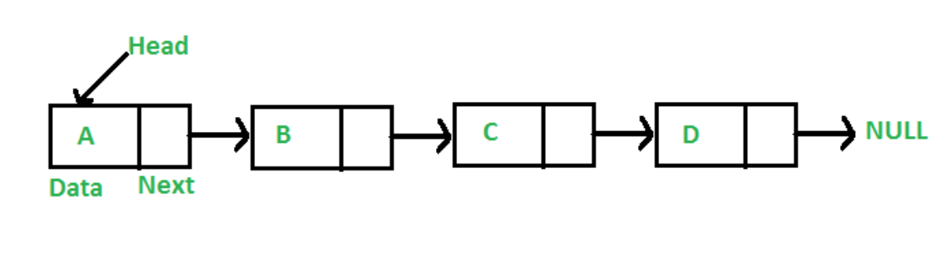
5. Linked List
A linked list is a linear collection of data elements whose order is not given by their physical placement in memory - Wikipedia
양방향으로 이동 가능하면 => Doubly Linked List
맨 끝과 앞을 연결하면 => Circular Linked List
Python을 이용한 구현은 https://realpython.com/linked-lists-python/ 참고
Q. List가 아닌 linked list로 stack과 queue를 구현하면 어떤 차이가 있을까?

Slide 8
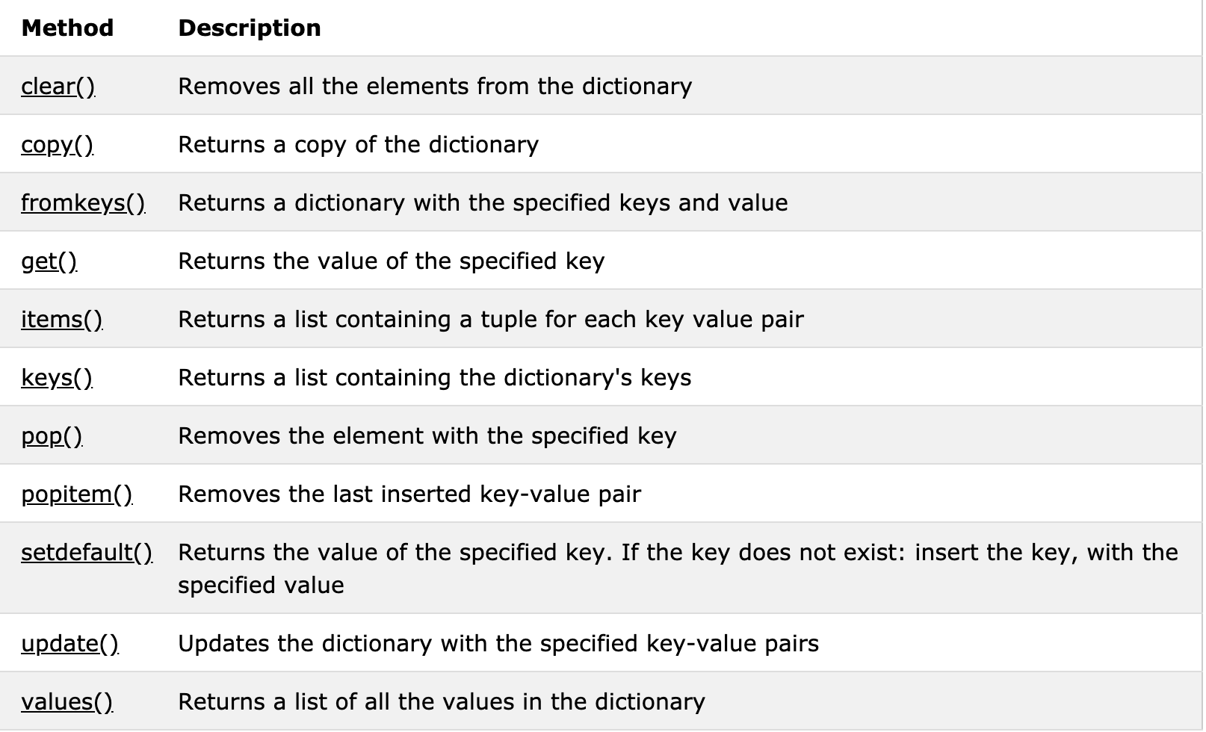
6. Hash Table (Dictionary)
A hash table (hash map) is a data structure that implements an associative array abstract data type, a structure that can map keys to values. 키와 그 키에 연결된 값의 대응관계를 저장하는 자료구조 - Wikipedia
함수 | 설명
len(a) | 딕셔너리 길이
d[key] | Key의 값 읽어오기
d[key] = value | Key 값 저장
del d[key] | 해당 Key 값 삭제
key in d | Key 존재 유무(T/F)
표. 자주사용하는 딕셔너리 기능
출처: 모두의 알고리즘 with 파이썬

Slide 9
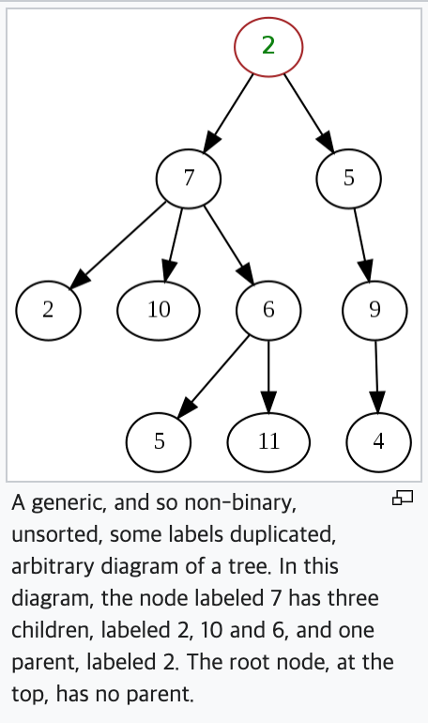
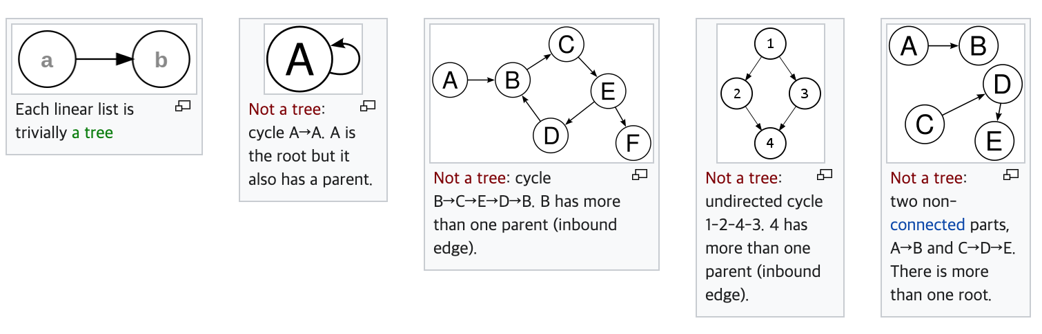
7. Tree
A tree is a widely used abstract data type (ADT) that simulates a hierarchical tree structure, with a
root value and subtrees of children with a parent node, represented as a set of linked nodes. - Wikipedia
기본 용어, 트리 종류

Slide 10
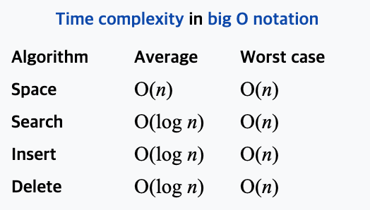
7.1. Binary Search Tree (BST)
A binary search tree (BST), also called an ordered or sorted binary tree, is a rooted binary tree
whose internal nodes each store a key greater than all the keys in the node's left subtree and less
than those in its right subtree. - Wikipedia

Slide 11

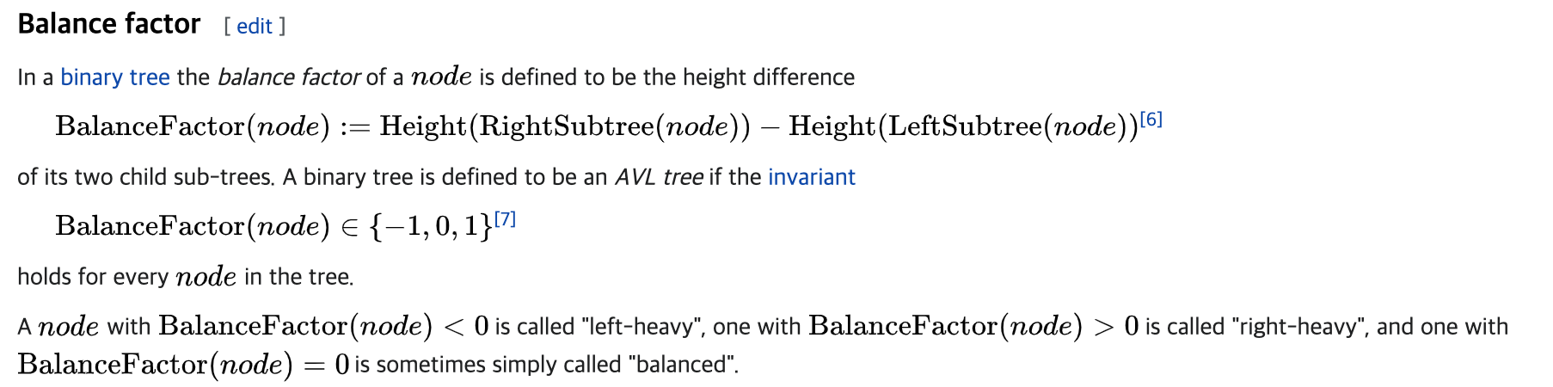
7.2. AVL Tree
An AVL tree (named after inventors Adelson-Velsky and Landis) is a self-balancing binary search tree. It was the first such data structure to be invented. - Wikipedia

Slide 12
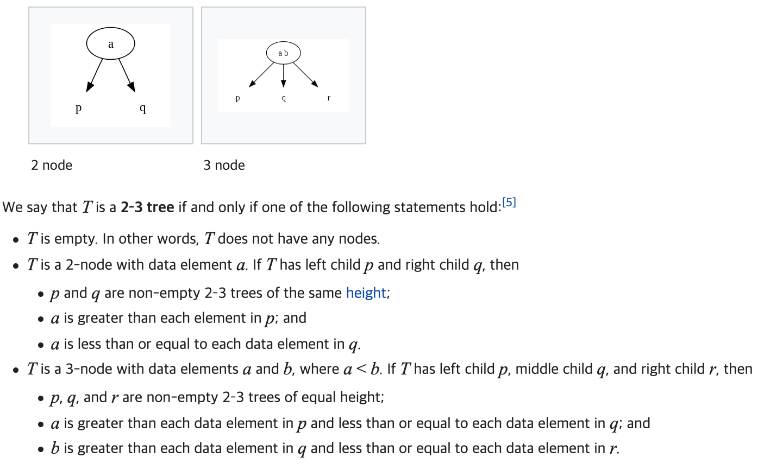
7.3. B-Tree
A B-tree is a self-balancing tree data structure that maintains sorted data and allows searches, sequential access, insertions, and deletions in logarithmic time. - Wikipedia
2-3 Tree

Slide 13
7.4. Red-Black Tree
A red–black tree is a kind of self-balancing binary search tree. Each node stores an extra bit representing color, used to ensure that the tree remains approximately balanced during insertions and
deletions. - Wikipedia
1. Each node is either red or black.
2. The root is black. This rule is sometimes omitted. Since the root can always be changed from red to black, but not necessarily vice versa, this rule has little effect on analysis.
3. All leaves (NIL) are black.
4. If a node is red, then both its children are black.
5. Every path from a given node to any of its descendant NIL nodes goes through the same number of black nodes.

Slide 14
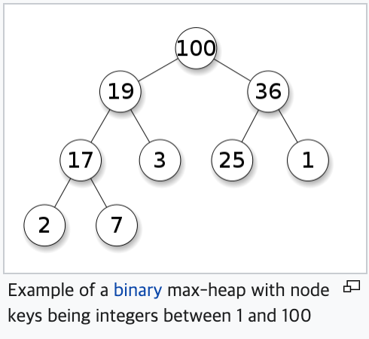
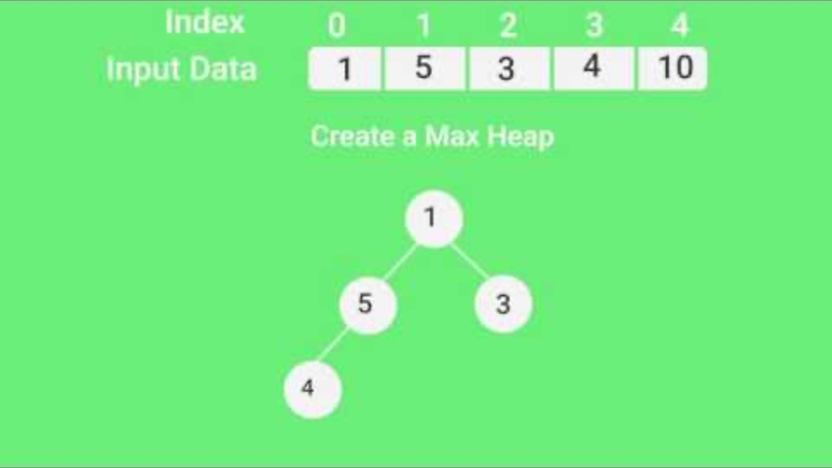
8. Heap
A heap is a specialized tree-based data structure which is essentially an almost complete - Wikipedia
Root만 제거하는 것에 유의!

Slide 15
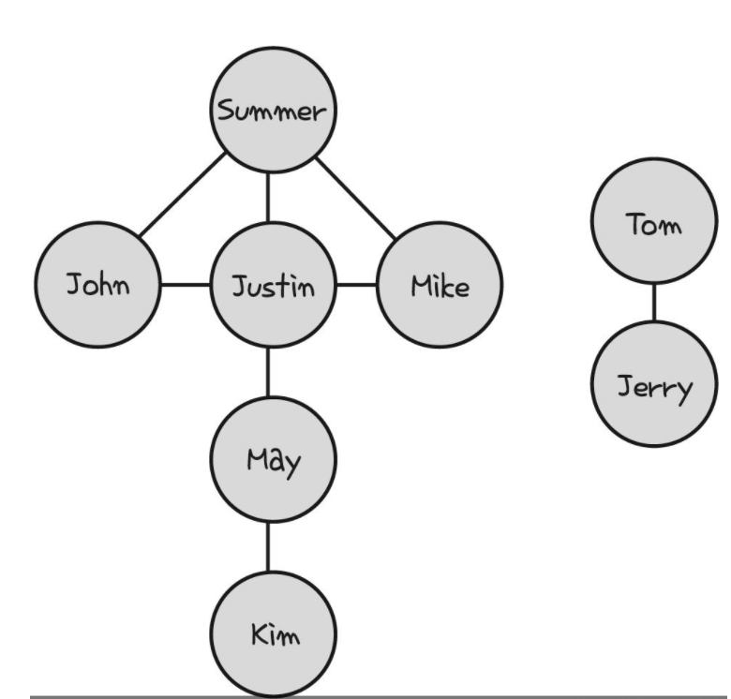
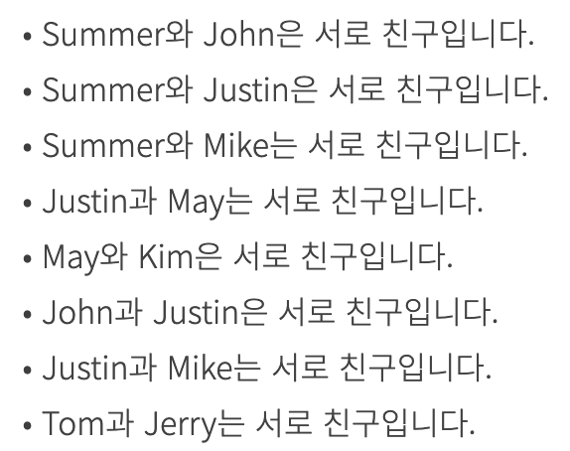
9. Graph
A graph is an abstract data type that is meant to implement the undirected graph and directed
graph concepts from the field of graph theory within mathematics. - Wikipedia
출처: 모두의 알고리즘

Slide 16
10. 문제풀이
1) 회문(Palindrome) 비타알고(난이도 별3)
2) Dictionary - 동명이인 찾기
3) Graph - 친밀도 계산
4) DFS/BFS – 단어 변환 프로그래머스(L3)

Slide 17
11. 자료 구조 공부
교과서
Problem Solving with Algorithms and Data Structures using Python
(파이썬으로 된 교과서 중 아마존에서 가장 많이 팔린 책)
무료 https://runestone.academy/runestone/books/published/pythonds/index.html
2) 인강
https://www.youtube.com/channel/UCZCFT11CWBi3MHNlGf019nw
UDEMY: Data Structures using C and C++ on Udemy
만원 내외 – C, C++ 사용 / 학교에서도 C로 공부하기 때문에 예습에 도움 + old school, 인도 영어 듣기 실력 향상은 덤
3) 문제 풀이 – 프로그래머스, 백준

